Slide 1
Artificial Intelligence
Lecture # 22, 23
Session#25, 26

Slide 2
Learning objectives
To enable students to
  Understand basic terminology related to Markov decision processes
  Understand basic terminology related to reinforcement learning

Slide 3
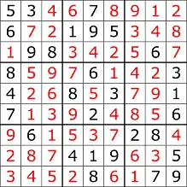

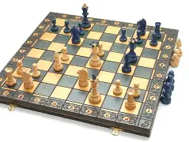
Model types
Four types in order of increasing generality:
  Simple reflex models
  State-based models
  Variable-based models
  Logic-based models
  Reflex State-based Variable Logic
  - Search-based - Constraint satisfaction
  - Markov decision - Bayesian networks
  - Adversarial

Slide 4
How do you get home from the University in the least amount of time?
  University bus
  Indrive
  Indrive+Metro

Slide 5
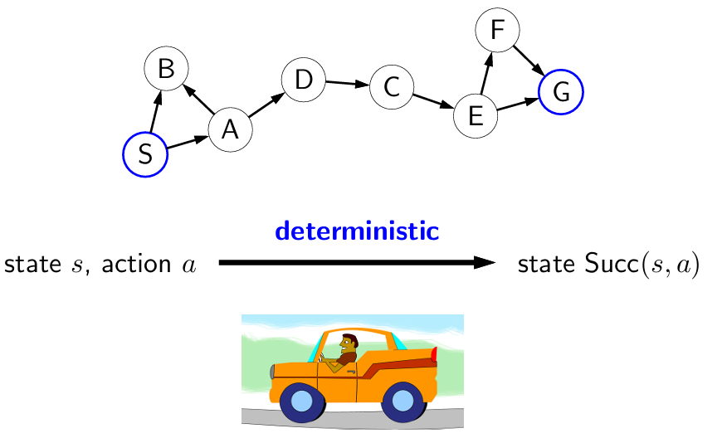
So far: search problems
The successor state was unique

Slide 6
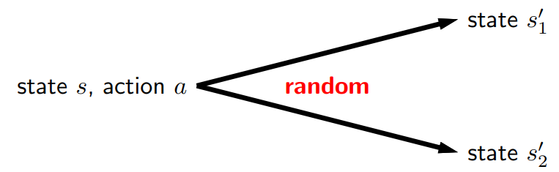
In the real world
The deterministic successor assumption is often unrealistic
  there is randomness
  taking an action might lead to any one of many possible states
  Can we hope to act optimally in the face of randomness?

Slide 7
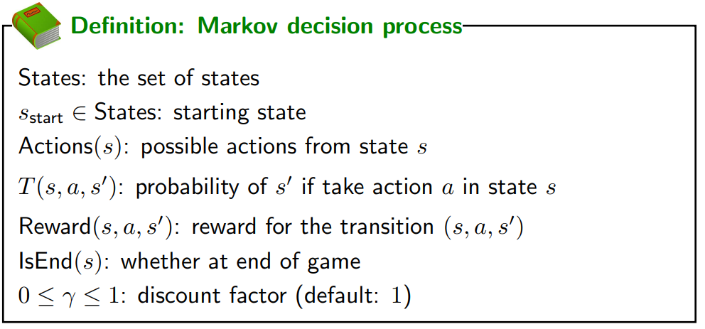
A transition distribution T, which specifies for each state s and action a, a distribution over possible successor states s’

Slide 8
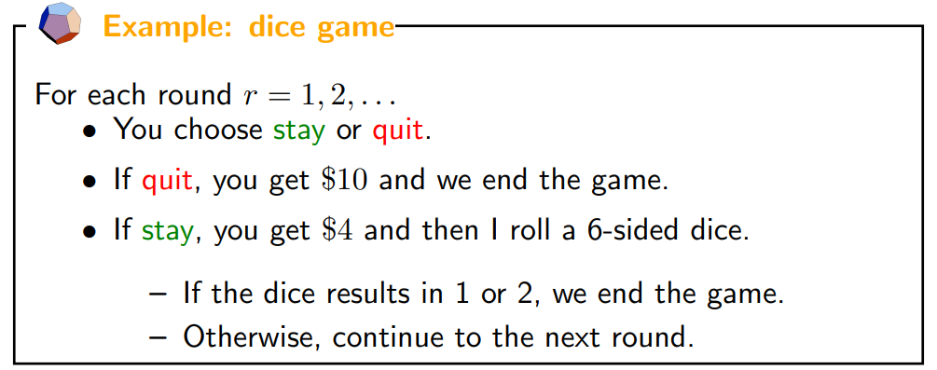

Slide 9
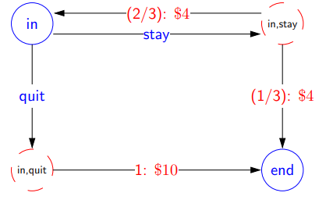
Edges coming out of states are the possible actions from that state, which lead to chance nodes
Edges coming out of a chance nodes are the possible random outcomes of that action, which end up back in states
Convention is to label the chance-to-state edges with the probability of a particular transition and the associated reward for traversing that edge

Slide 10
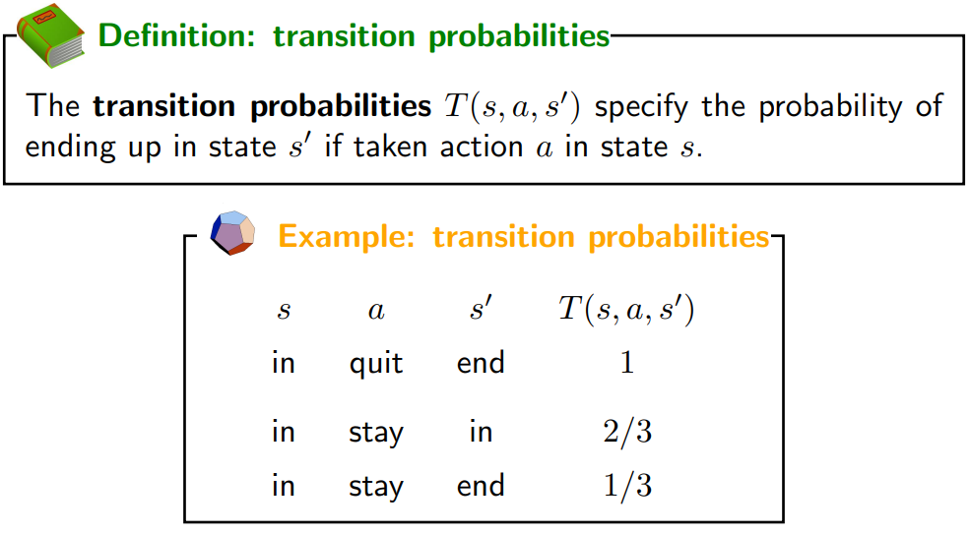
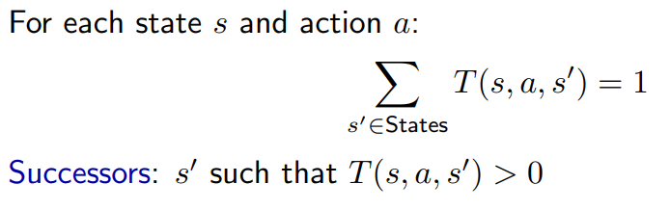
Transitions

Slide 11
Generally, the number of successors of a given (s, a) is much smaller than the total number of states. For instance, in a search problem, each (s, a) has exactly one successor

Slide 12
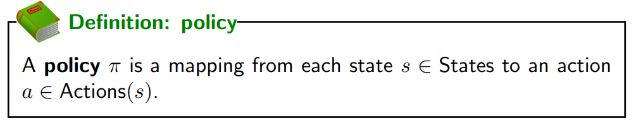
Solution?
For search problems, we were trying to find the minimum cost path
For MDPs, we define a policy, which specifies an action for every single state

Slide 13
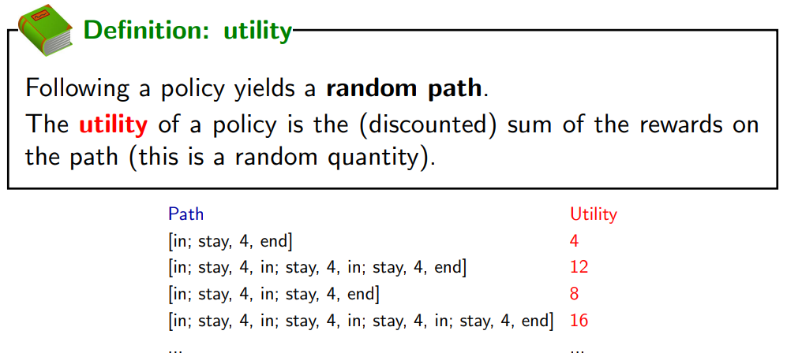
Evaluating a Policy
Utility is a random variable

Slide 14
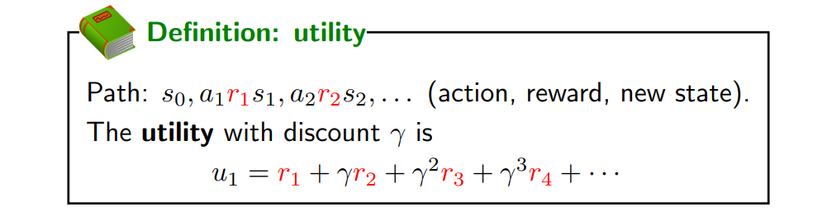
Discounting

Slide 15
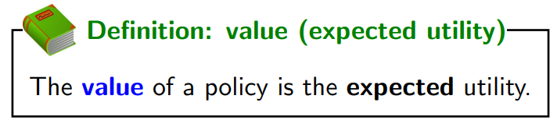
We want to maximize the total rewards (utility) - but can we maximize a random quantity?
Instead, maximize the expected utility, which is referred to as value (of a policy)
Value=E[U]

Slide 16
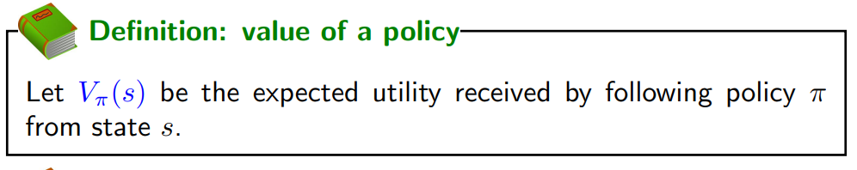
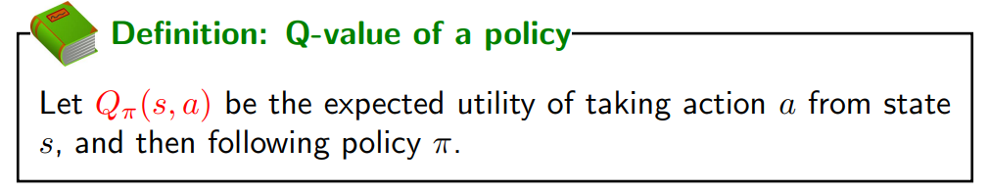
Policy evaluation

Slide 17
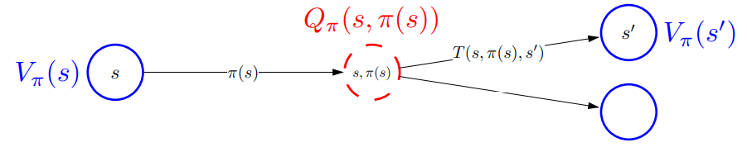
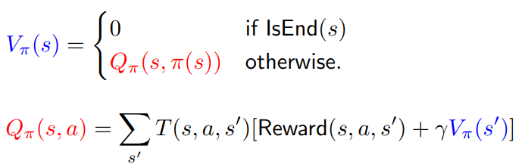

Slide 18
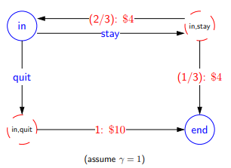
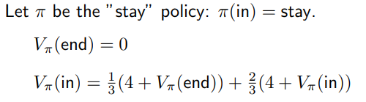
Policy Evaluation for Dice Game
Do policy evaluation for all states
Simple in this case because of only two states
The value of end state is known

Slide 19
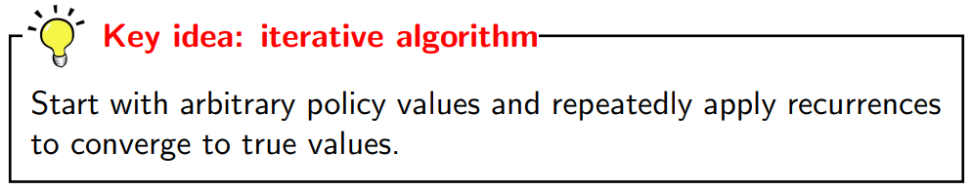
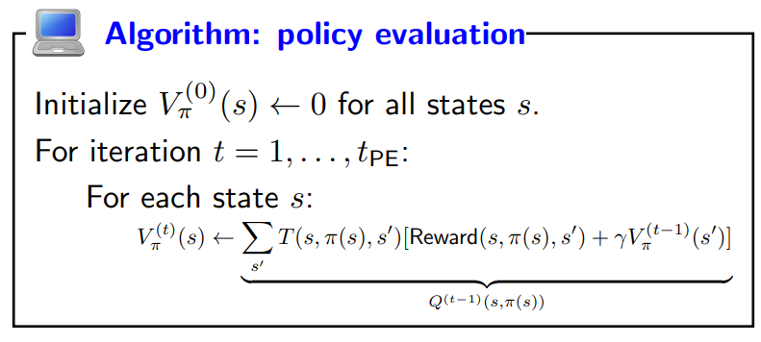
Policy evaluation

Slide 20
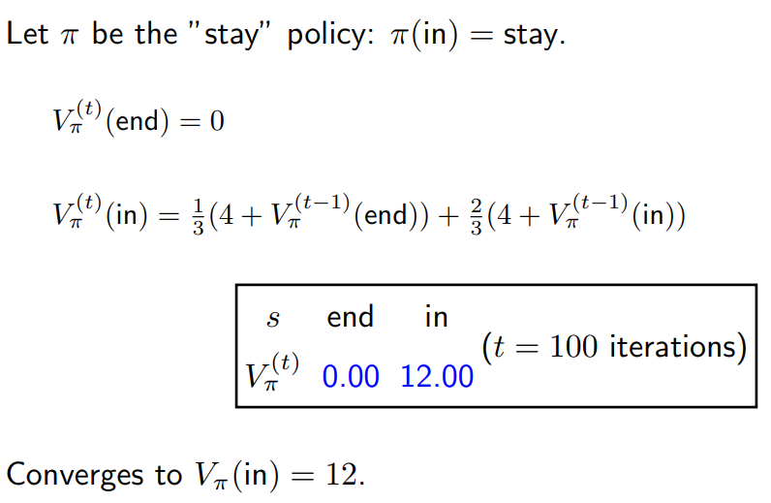
Policy evaluation on dice game

Slide 21
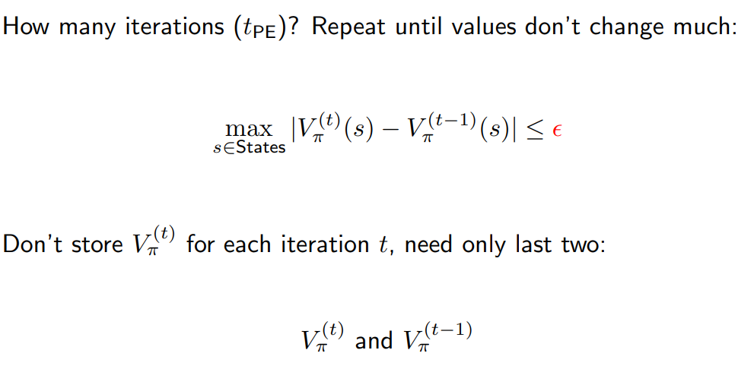
Policy evaluation implementation

Slide 22
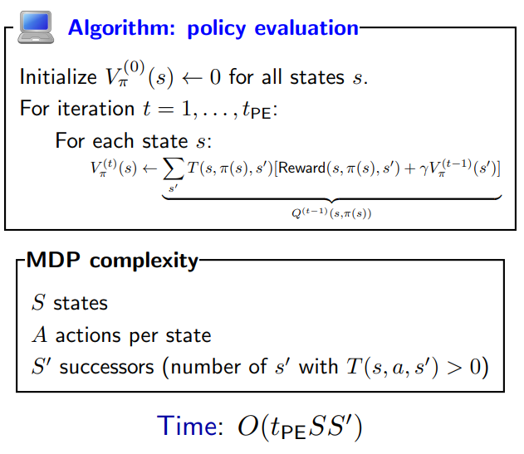

Slide 23
Session # 26

Slide 24
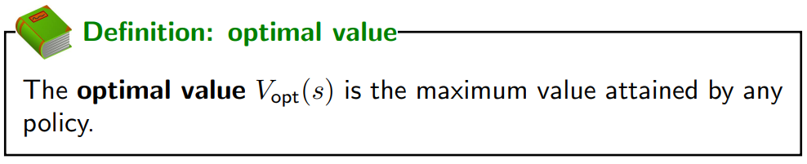
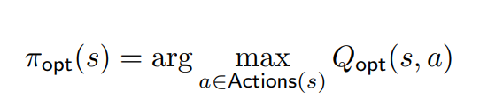
Optimal Value and Policy

Slide 25
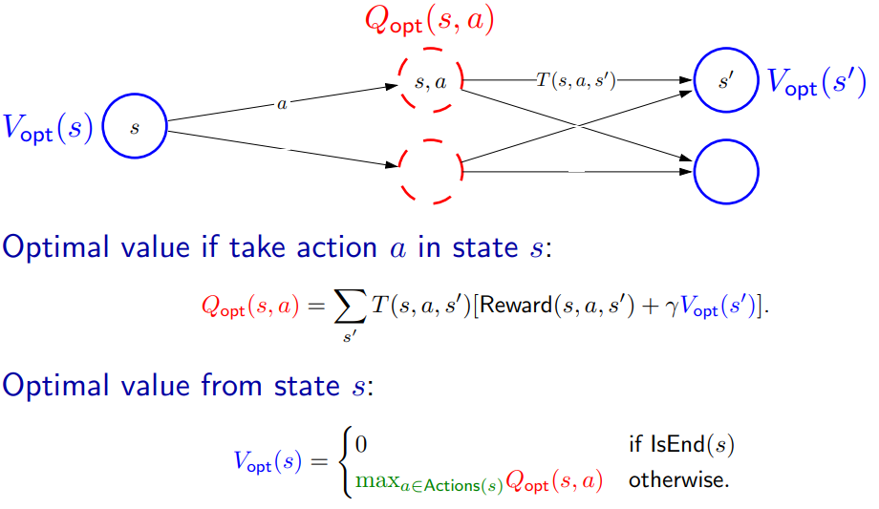

Slide 26
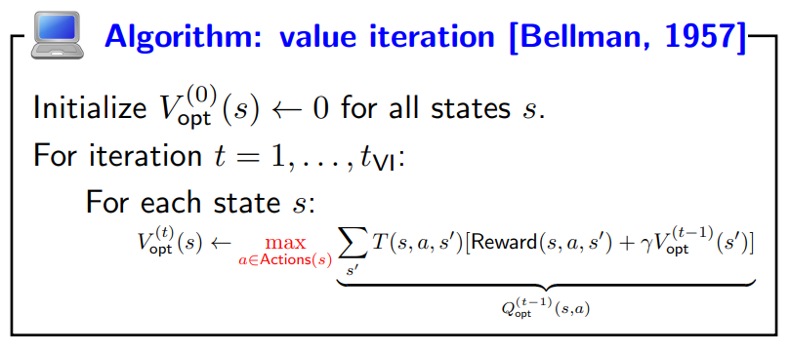

Value iteration

Slide 27
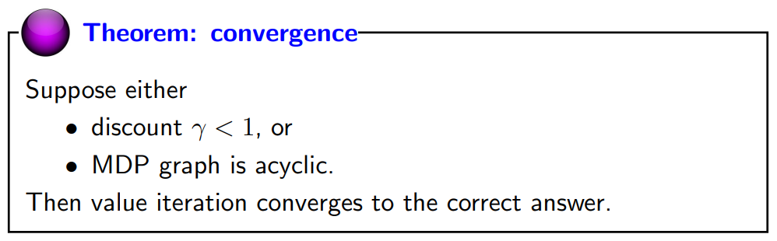
Convergence

Slide 28
Reinforcement learning

Slide 29
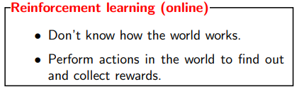

Slide 30
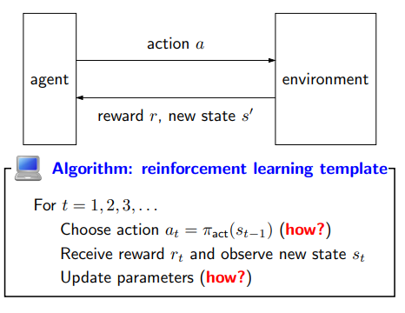
Reinforcement learning framework

Slide 31
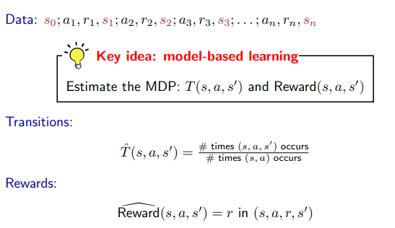
Model-based Monte Carlo

Slide 32
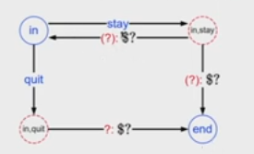
[in; stay,4, in; stay,4, in; stay,4, in; stay,4, end] Prob. ¾, ¼ & r=4
[in; stay,4, in; stay,4, end] Prob 4/6, 2/6
[in; stay,4, end] Prob 4/7, 3/7

Slide 33
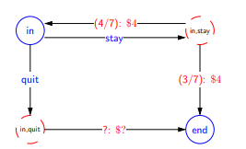
Estimates converge to true values
Once we have the estimated MDP, use it to find Q_{opt}

Slide 34
